Slide 1
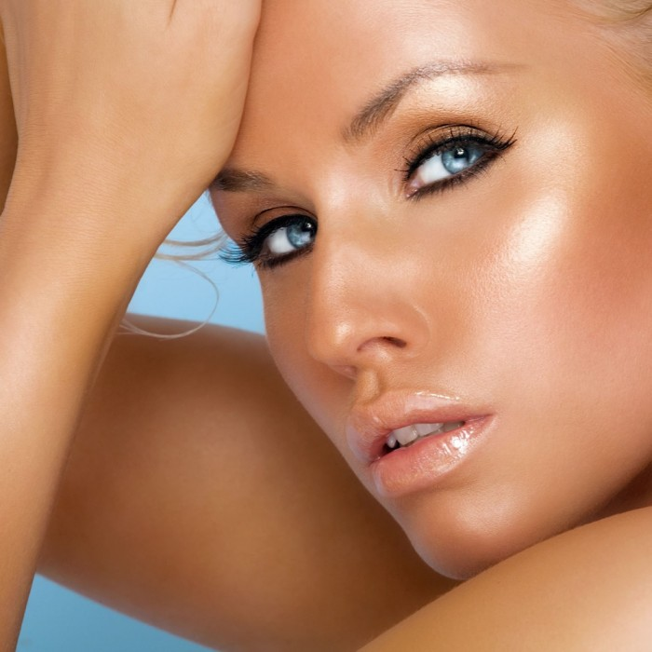
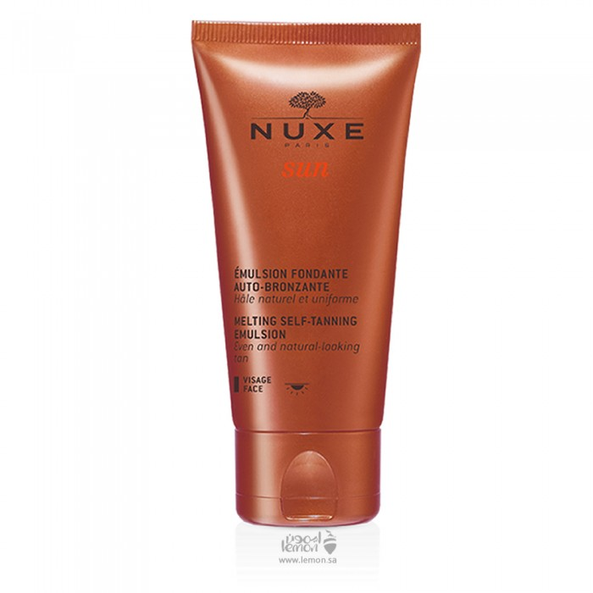
Bronze Skin Color Nailing Skin Without Sun Exposure Self Tanning Self Emulsion Tan Face
138.00 SAR. Q
Knox Tan Self Emulsion gives the face bronze without exposure to the sun (self tanning) gives you a color that lasts for a whole week of the first use, moisturizes the skin and is suitable for all skin types. This soft texture of this facial self-tanning care, which contains water and sun flowers, is easily accessible to the skin to ensure easy use that leaves no lines and marks. In two hours, without exposure to the sun, it helps to get a natural uniform and bright tan. Skin gets perfect moisturization and brightens it as luminous as summer.

Slide 2
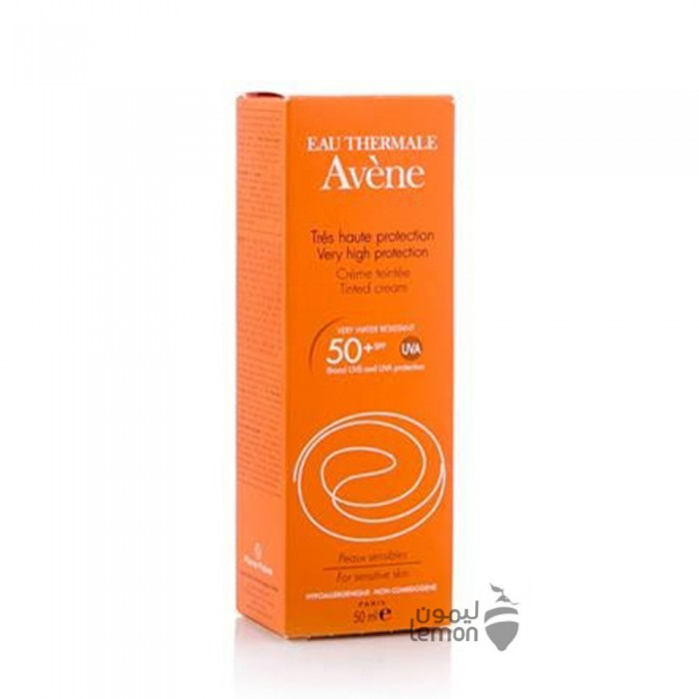
Avin
Aven Sunscreen Protection Factor 50 + (Colored) 50 ml
SAR 159.85 Q
How to use:
Apply evenly on the skin before exposure to sunlight. Reapplication often in case of prolonged exposure to the sun, after swimming.

Slide 3
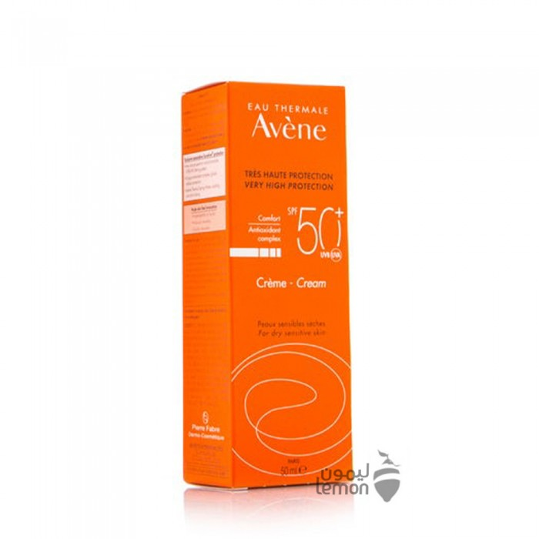
Avin
Avin sunscreen with 50 + protection factor (light color) 50 ml
SAR 156.40. Q
How to use:
Apply evenly on the skin before exposure to sunlight. Reapplication often in case of prolonged exposure to the sun, after swimming.

